Slide 1




RIVER REVERSALS AND THE METABOLIC REGIMES OF FLORIDA’S SPRINGS
Samantha T. Howley¹, Yusueng Shin¹, Matt Cohen²
School of Natural Resources and Environment (1)
School of Natural Forest, Fisheries, and Geomatic Sciences (2)
University of Florida | IFAS, Gainesville, FL 32611

Slide 2
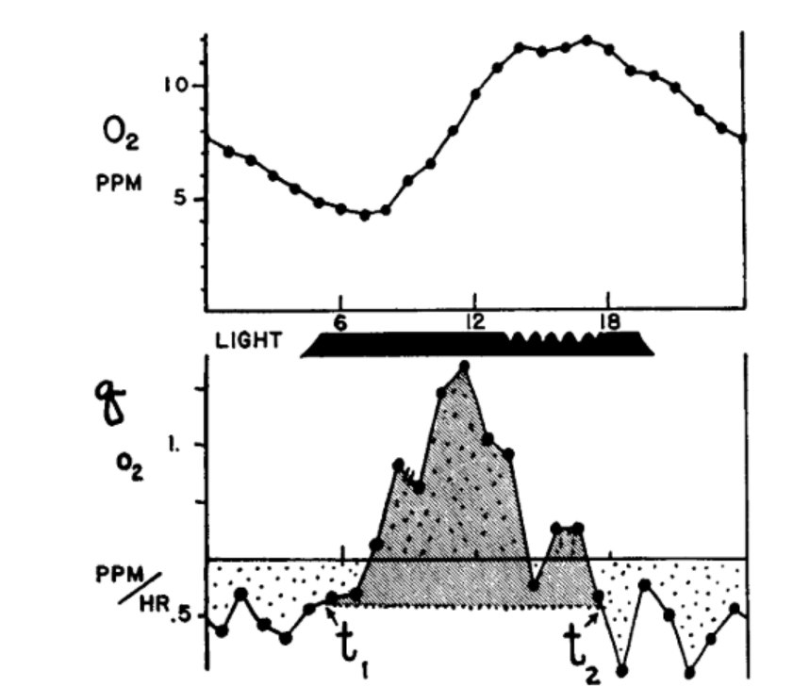

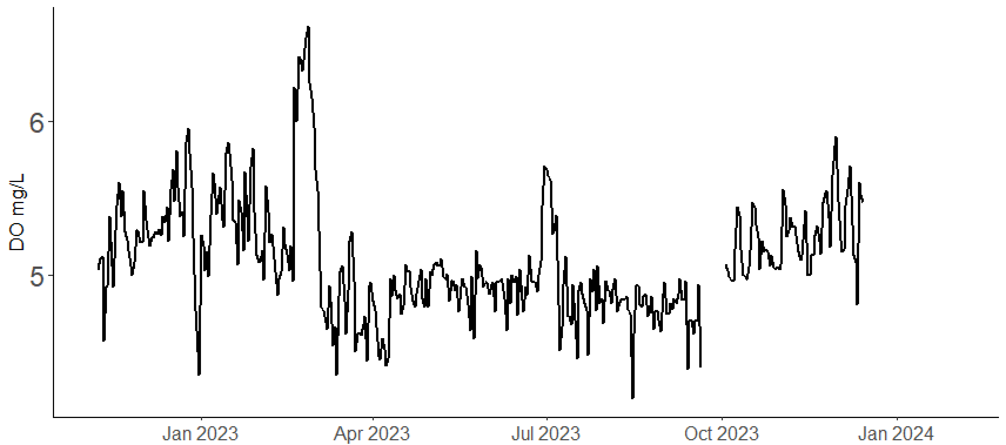
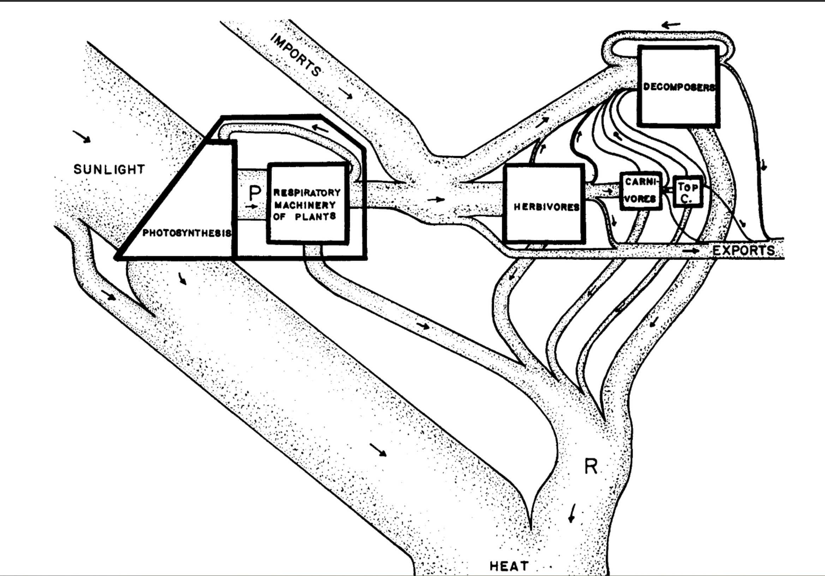

Metabolic Regime: the productivity of an ecosystem over a study period.
Stream metabolism: the energy flow through out an ecosystem via gross primary
Productivity (GPP) and ecosystem respiration (ER).
Gross Primary Productivity (GPP): total photosynthesis; producing oxygen.
Net Ecosystem Productivity (NEP) = GPP-ER
Ecosystem Respiration (ER): total respiration; consuming oxygen.
Primary Production of Flowing Waters (1956), HT Odum
Primary Production of Flowing Waters (1956), HT Odum
Notes:
Before I begin, briefly, the metabolic regime of flowing waters refers to a stream or rivers productivity over a study period.
But it’s first found by modeling a stream’s daily metabolism
Stream metabolism is the energy flow through out an ecosystem via
gross primary productivity, GPP, organisms producing oxygen and
Ecosystem respiration, ER, consuming oxygen
Therefore, stream metabolism models estimates productivity by tracking the hourly changes in dissolved oxygen
These photos are from the classic publication, the Primary Production of Flowing Waters where HT Odum researched the metabolic regime of… North Florida’s springs ☺
Historically, modeling stream metabolism was challenging. Each of these little dots was hand sampled
Because of this, classic stream metabolism literature only encompassed a few days, and only observed normal, undisturbed conditions
In there present where high-frequency, durable DO sensors are available, stream metabolism experiments are much easier to conduct, and furthermore can encompass disturbed and non-disturbed days.

Slide 3










Influences on stream metabolism:
Energy:
Inputs:
Flow Velocity
Seasons
Light Availability
Flow Velocity
Organic Matter
Canopy Cover
N-P
Biomass density
Nutrients
Recalcitrance
Temperature
Depth (stage)
Disturbance
Bernhardt et al., 2019; Hall et al., 2015; Julian et al., 2008; LeRoy Poff et al., 1997
Acuña et al., 2004; Fuss & Smock, 1996;Meyer & Edwards, 1990; Mulholland et al., 2001
Notes:
Stream metabolism, and stream metabolic regime, is dictated by a multitude of factors that I have listed above such as canopy cover, disturbance, and nutrient concentrations but in my opinion, light, OM quality/quantity, and flow are the majoring determining factors. Light powers photosynthesis, OM is influential for ER, and flow velocity determines the export of solutes and biomass density.

Slide 4

Welcome to North Florida’s Springs
Odum, 1956; 1957
Notes:
Which brings me to my study sites, North Florida springs! A terrible place to do fieldwork!
Due to the upper Floridian aquifer (the UFA) discharging groundwater to the springs at a near constant rate and at a near constat temp of 73 degrees F year-round, FL’s springs have some of the clearest, stable and most productive waters in the world
When HT Odum studied N FL springs, specifically Ichetucknee and Silver river, he described productive, clear, stable-flowing, waters with a distinct upstream and downstream.

Slide 5
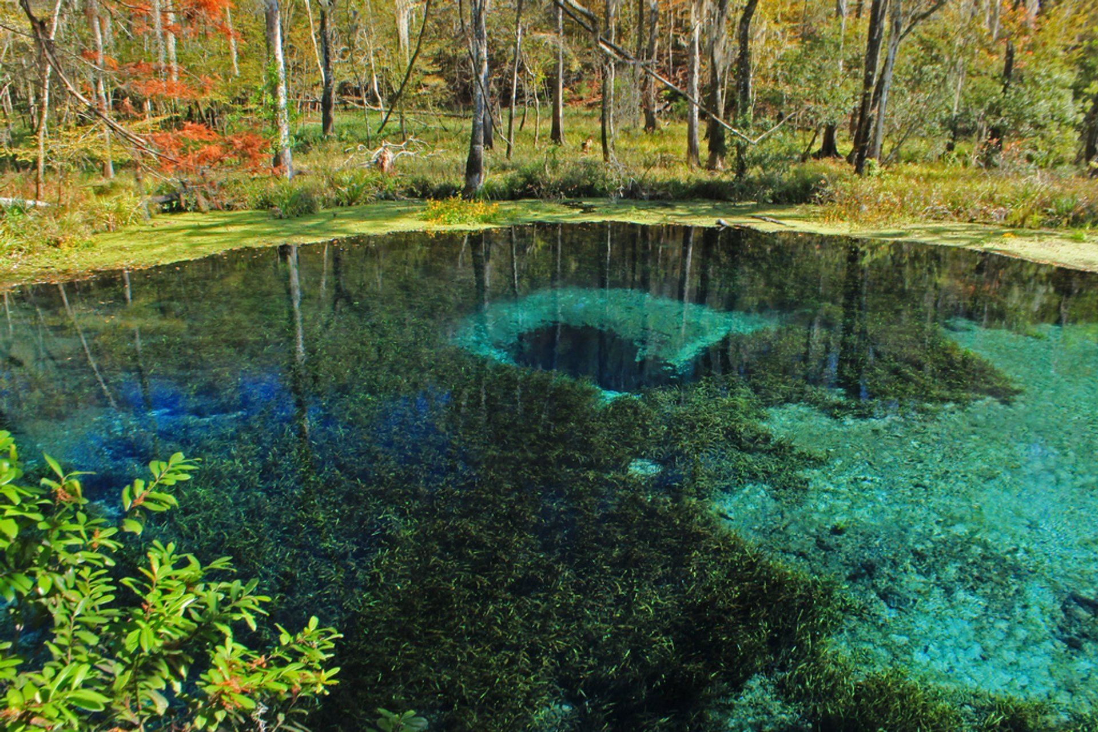
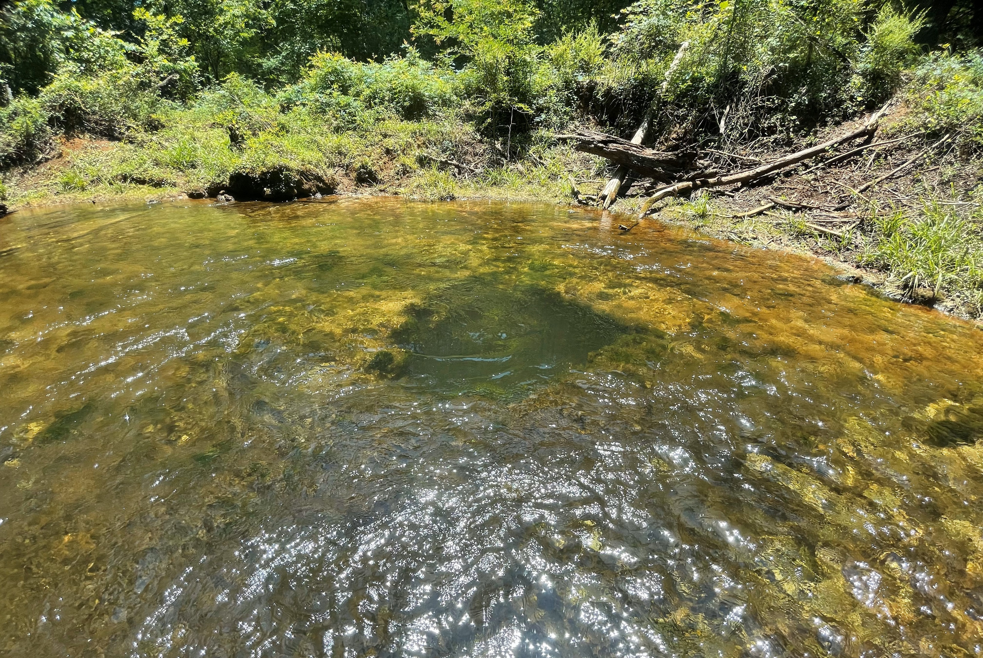
…but they don’t all look like that…
Ichetucknee Blue Hole
Allen Mill Pond
Notes:
An although that is true for Ichetucknee and Silver River, that does not apply to all N Fl springs. Most reaches are much shorter (~500m), and their water is more green than blue

Slide 6


…nor are do they all have stable flow…
Gilchrist Blue Spring
Notes:
Nor do they all have stable flow regimes. Many of Florida’s spring have dynamic stage, and therefore flow. Although these springs don’t experience drought, they do flood…

Slide 7






River reversals (backwater floods)
River Reversals (RR)
High stage events
Brown out
Flow reversal
Increasing Disturbance Magnitude
Hensley et al. 2017
Normal
Notes:
Most of Florida’s springs discharge into a downstream blackwater river.
Spring vents are located at higher elevation with the river-spring confluence at lower elevation.
After prolonged precipitation (conditions that would cause flooding), the river’s water level will rise, minimizing the elevation difference between the spring and the river
In all situations, the river will block or hinder spring discharge raising the stage.
But in the most severe scenarios, a backwater effect happens, meaning, the river’s elevation can even exceed the springs causing the river to flow into the springs.
A high stage event occurs when the river acts like dam. Spring discharge is inhibited, water is accumulated within the run, and stage increases BUT water clarity is maintained
A brownout occurs when the river elevation exceeds the spring-run. River water will enter and mix with spring water, and flow is stopped. Water is clarity is also reduced.
For flow reversals, the river exceeds the spring vent and will flow into the run, displacing spring water. In this situation, the headwaters will have switched, and flow is backwards.

Slide 8
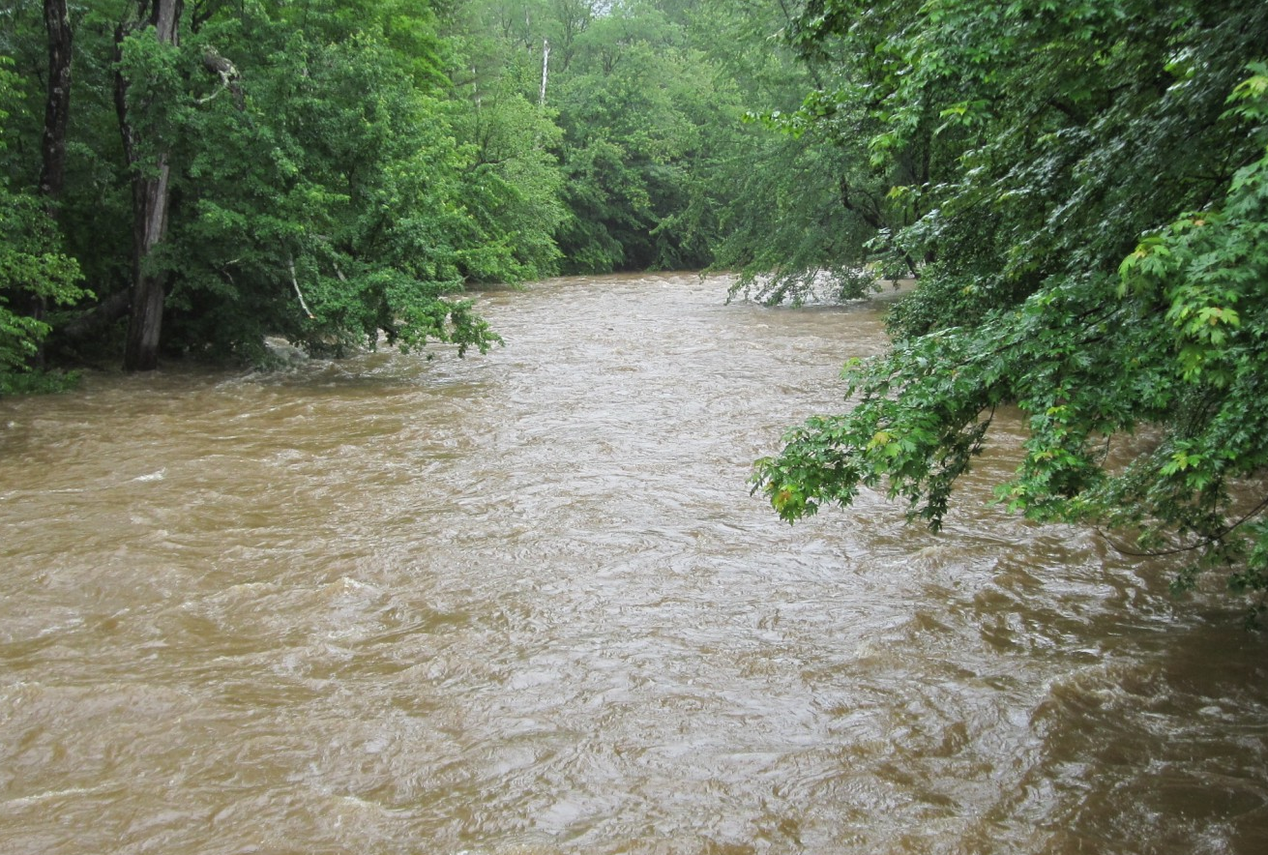




Spring-runs do not experience bed scour during floods.
Bed Scour
Gilchrist Blue Springs
Notes:
Typical stream floods and river reversals are similar. They both experience an increase stage and reduced water clarity, but springs do not experience bed scour
In most streams, fast-flowing flood-waters causes bed scour, the physical removal of a stream's benthic material
During a river reversal, flow is diminished so there is no bed scour. The benthos is retained but under meters of water, sometimes blackwater

Slide 9
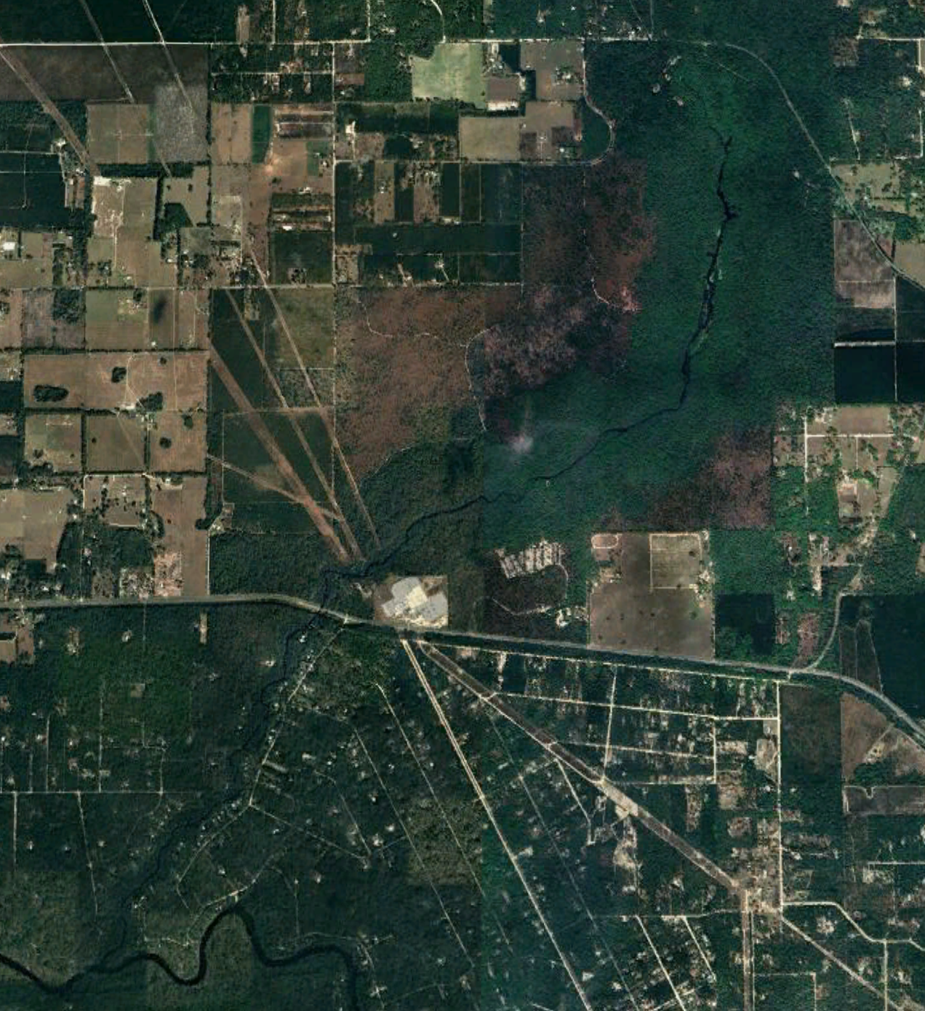




Florida springs belong to a gradient of flow regimes, and therefore, disturbance regimes.
Ichetucknee River
Gilchrist Blue Spring
Rum Island Spring
Disturbance Regime
distance
Susceptibility to River Reversals:
elevation
Notes:
Florida springs belong to a gradient of flow regimes where some river-reversing with every major rain event , and others rarely ever experiencing a high stage event.
A springs susceptibility to a river reversal is a largely dependent 1) its vent elevation and 2) its proximity to its receiving blackwater river (how long its spring run is)
Ichetucknee river, a spring with a long run, is rarely disturbed and is known for its clear waters and thick mats of macrophytes
but shorter springs that experience a quarter to half the year brown (such as rum island ) tend to have less biodiversity and are murkier

Slide 10

I sought an improved understanding of spring metabolic regimes across a gradient of flow impacts.
What are the metabolic impacts of spring river-reversals, especially in the absence of bed scour?
H1. Spring-run productivity will decline during floods, despite the absence of bed scour
Are springs with greater disturbance frequency less productive than less disturbed springs?
H2. Flood magnitude will be positively correlated with metabolic recovery time and metabolic reduction.
H1. Frequently disturbed springs will have less stable metabolic regimes than rarely disturbed springs.
Notes:
For this project, I sought to understand how spring backwater floods (river reversals and high stage events) impact spring metabolism
Furthermore, I wanted to understand, if and how disturbance influences spring typology. Specifically,…
Are springs with greater disturbance frequency less productive than less disturbed springs?
What are the metabolic impacts of these spring inverted-flood in the absence of bed scour?

Slide 11
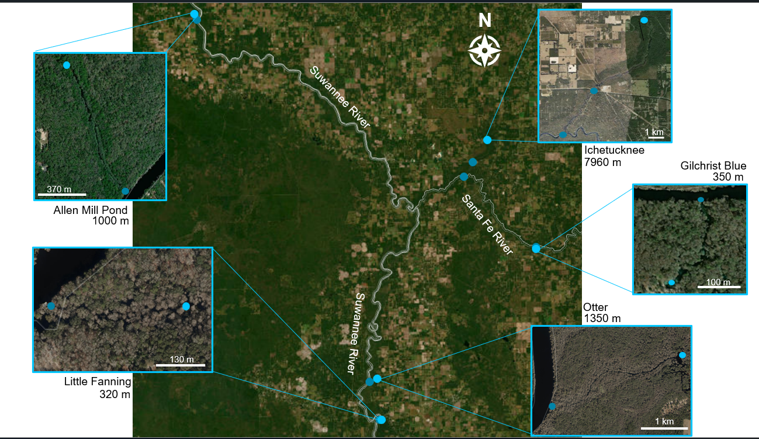

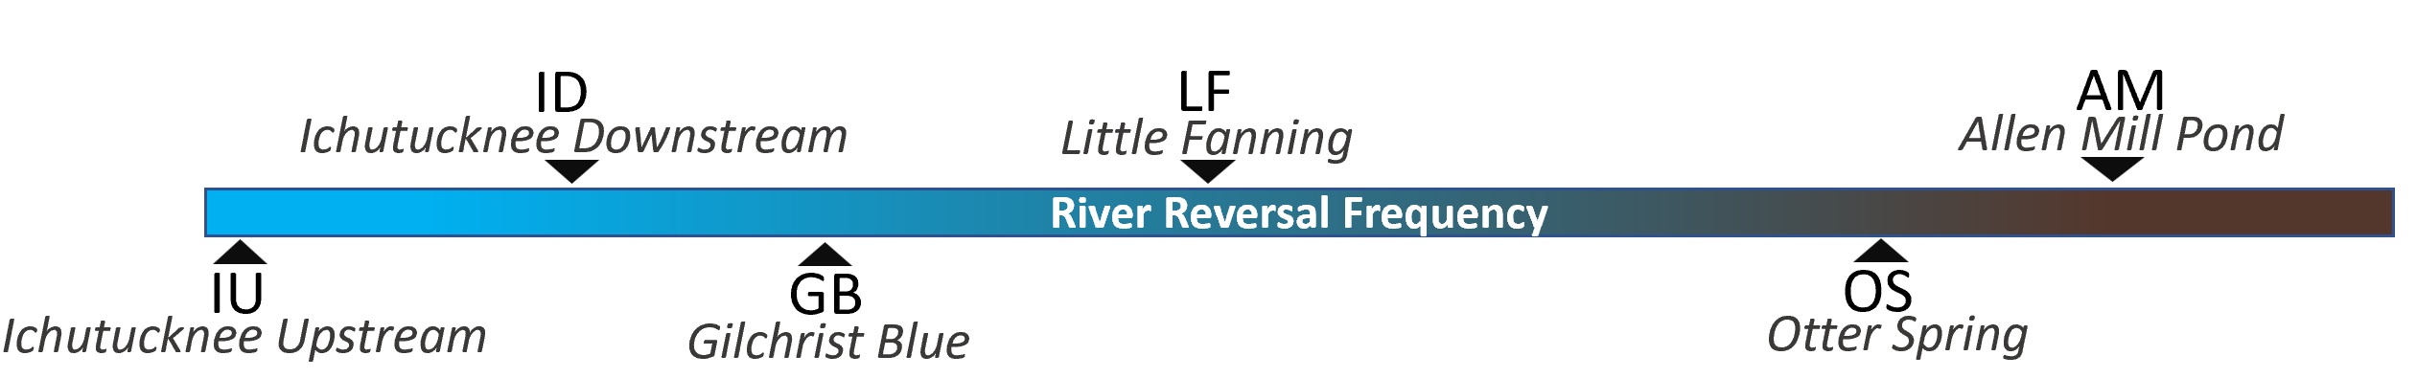
Methods: Study Sites
Two-Station Metabolism
One-Station Metabolism
downstream
Normal
Flooded
upstream
Riley & Dodds et al. 2023; Reichert et al., 2009; Demars et al., 2015
Notes:
To explore my hypothesis, I selected 5 spring-runs spanning a river-reversal frequency gradient including the iconic Ichetucknee river to the frequently reversing Allen Mill Pond; it spends half of the year brown.
I estimated each sites stream metabolism using two-station methods during normal conditions and one-station methods during flooded conditions.
The project is ongoing, and I began monitoring these sites in late 2021

Slide 12
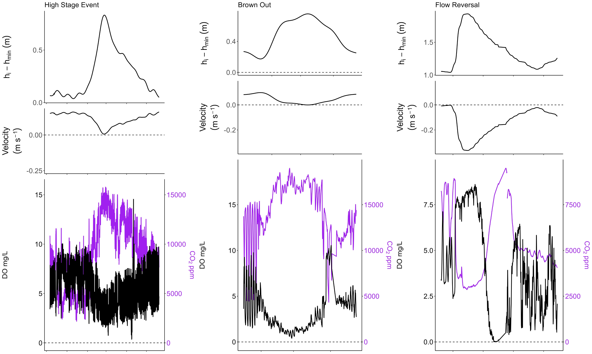
Dissolved oxygen (DO) decreased, and CO2 increased with increasing stage. River reversals caused hypoxia.
H1. Spring-run productivity will decline during floods, despite the absence of bed scour
Notes:
Before any modeling, a pattern emerged between stage, CO2 and DO
For every flood, as stage increased, DO decreased and CO2 increased in tandem displaying strong coupling
AND The degree in which DO and CO2 changed aligned with each floods disturbance severity
For high stage events, O2 decreased and CO2 increased with the rise in stage.
For every river reversal, the spring run became hypoxic whether a brownout (mixing) or a flow reversals.
However, during a flow reversal at the height of each disturbance, DO spikes and then dramatically falls. This an indicator of a true flow reversal. The river has higher DO concentrations than the groundwater-fed spring. The spike is the moment in which river water displaced spring water at the sensors location.

Slide 13
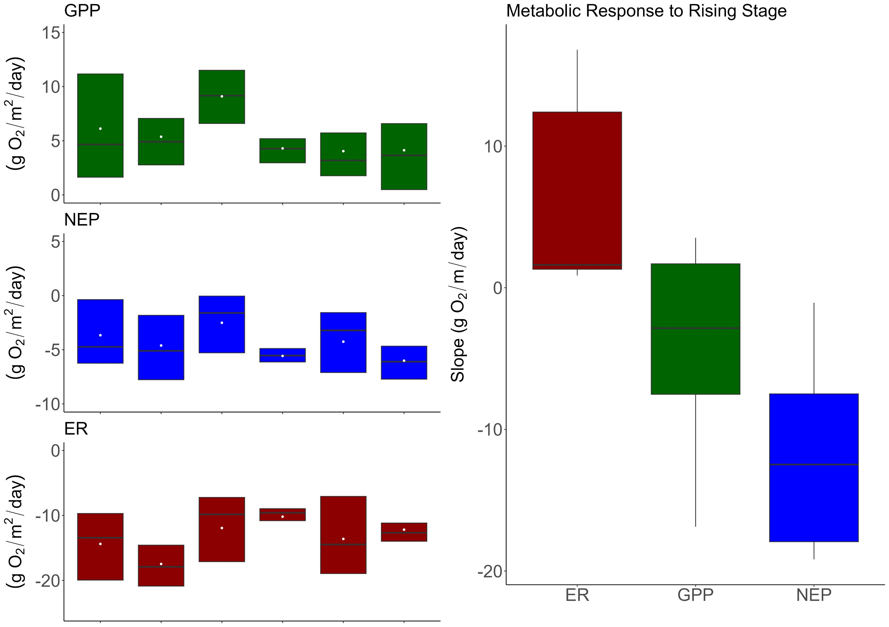
Stage and productivity have a negative relationship, regardless of river influence.
H1. Spring-run productivity will decline during floods, despite the absence of bed scour
Notes:
Moving on, here are the stream metabolism results across sites including disturbed and non disturbed periods.
Most of my sites were heterotrophic with LF and AM being the exception. They are exceedingly productive.
Across sites, a trend like DO’s emerged: as stage increased, GPP decreased, and ER increased.
In summary, when stage went up, productivity fell, even for the more chemostatic sites, indicating depth and flow are significant factors in spring metabolic regime.

Slide 14
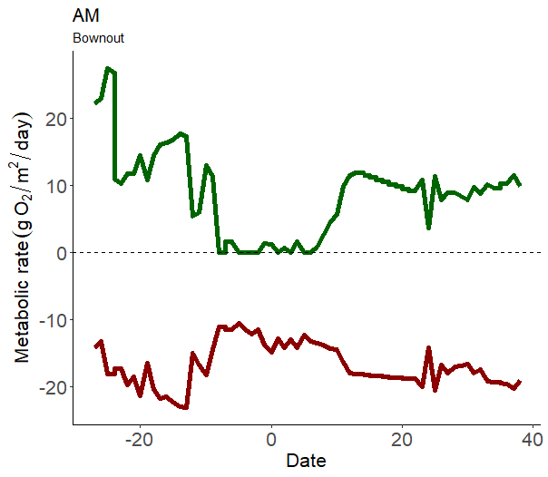

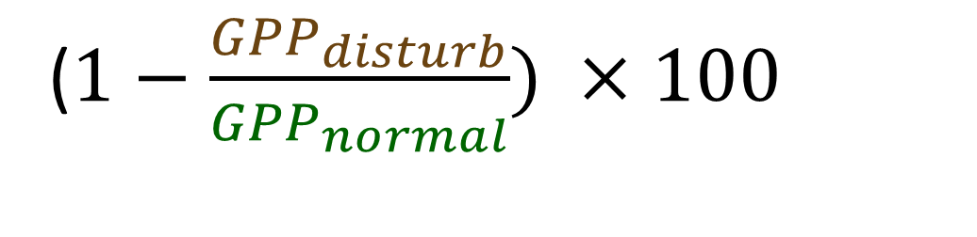
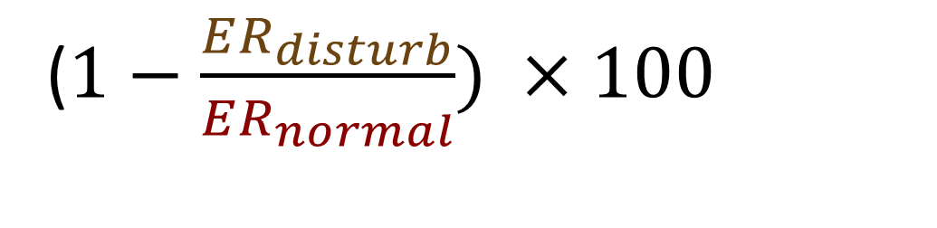
Is disturbance magnitude correlated with spring-run metabolic degradation?
Percent Reduction:
($1−\frac{{GPP}_{disturb}}{{GPP}_{normal}}) ×100$
($1−\frac{ER_{disturb}}{ER_{normal}}) ×100$
Cite AJ
Notes:
Zooming in, I wanted to explore whether the severity of disturbance impacts was dependent on spring disturbance magnitude.
Using simple percent-reduction equations

Slide 15
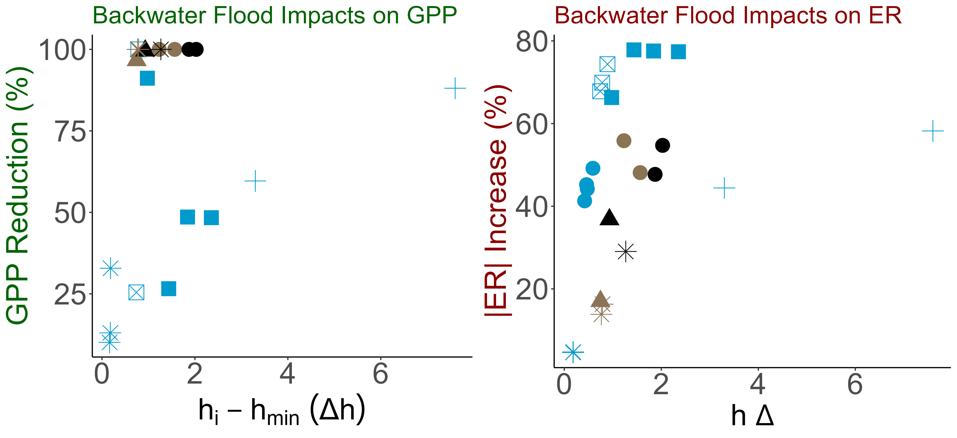
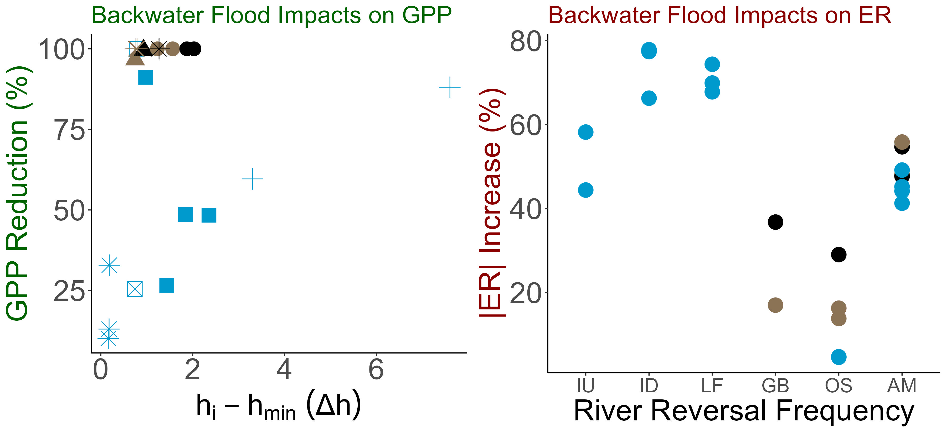

, ER tended to increase with increasing stage. River reversals drove GPP to 0, regardless of flood magnitude.
H2. Flood magnitude will be positively correlated with metabolic recovery time and metabolic reduction.
ER increases
ER increases
GPP decreases
GPP decreases\
Acuna et al., 2004; Reisinger et al., 2017
Notes:
In this figure, the x axis represents the difference between the stage minimum and the flood stage.
On the y axis I have the percent reduction
Once water become brown, GPP was diminished, regardless of flood magnitude and emphasized how light availability is strongly linked to spring productivity
For high stage events, GPP and stage have a negative relationship with GPP decreasing with an increase in stage.
As for ER, ER did not increase with disturbance magnitude but did have a positive relationship with stage. Although this trend is significant, as stage increased, ER tended to increase. There seems to be some clustering among sites but minimally
Overall, river reversals drove GPP to 0 while ER tended to increase with increasing stage.

Slide 16
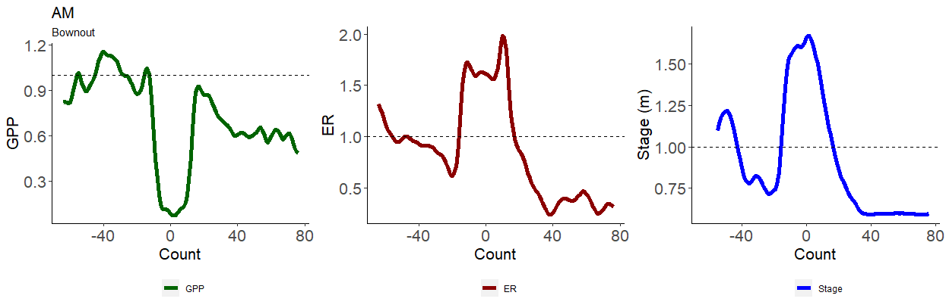
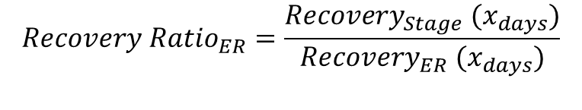
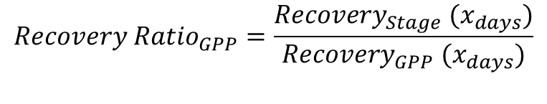
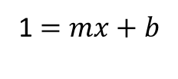
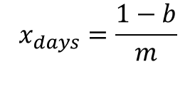
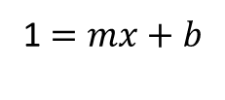
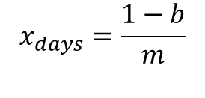
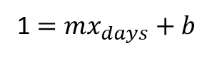
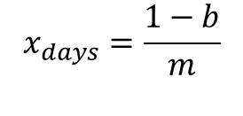
Is disturbance magnitude correlated with spring-run recovery?
$$x_{days}=\frac{1−b}{m}$$
$$x_{days}=\frac{1−b}{m}$$
$$x_{days}=\frac{1−b}{m}$$
1 $=mx_{days}+b$
1 $=mx+b$
1 $=mx+b$
$$Recovery Ratio_{GPP}=\frac{Recovery_{Stage} (x_{days})}{Recovery_{GPP} (x_{days})}$$
$$Recovery Ratio_{ER}=\frac{Recovery_{Stage} (x_{days})}{Recovery_{ER} (x_{days})}$$
Recover Ratio > 1; Metabolism recovered quicker.
Recover Ratio < 1; Stage recovered quicker .
Reisinger et a. 2017.
Notes:
Continuing this thread, a spring’s recovery dependent on disturbance regime or disturbance magnitude, or both?
For this, I fitted a linear regression between the height of the disturbance and when the spring-run recovered
I extracted this linear relationship to estimate recovery time
I divided GPP and ER recovery by stage’s recovery and called these ratios, recovery ratios

Slide 17
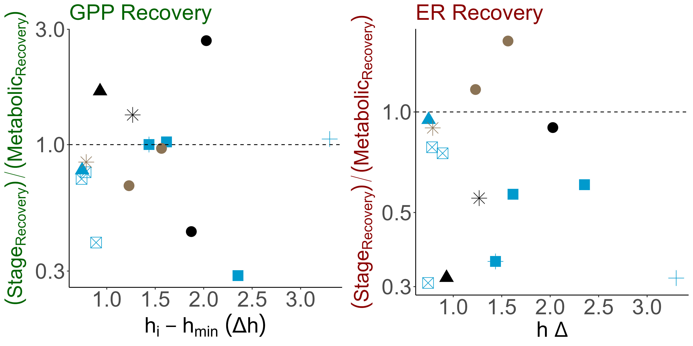
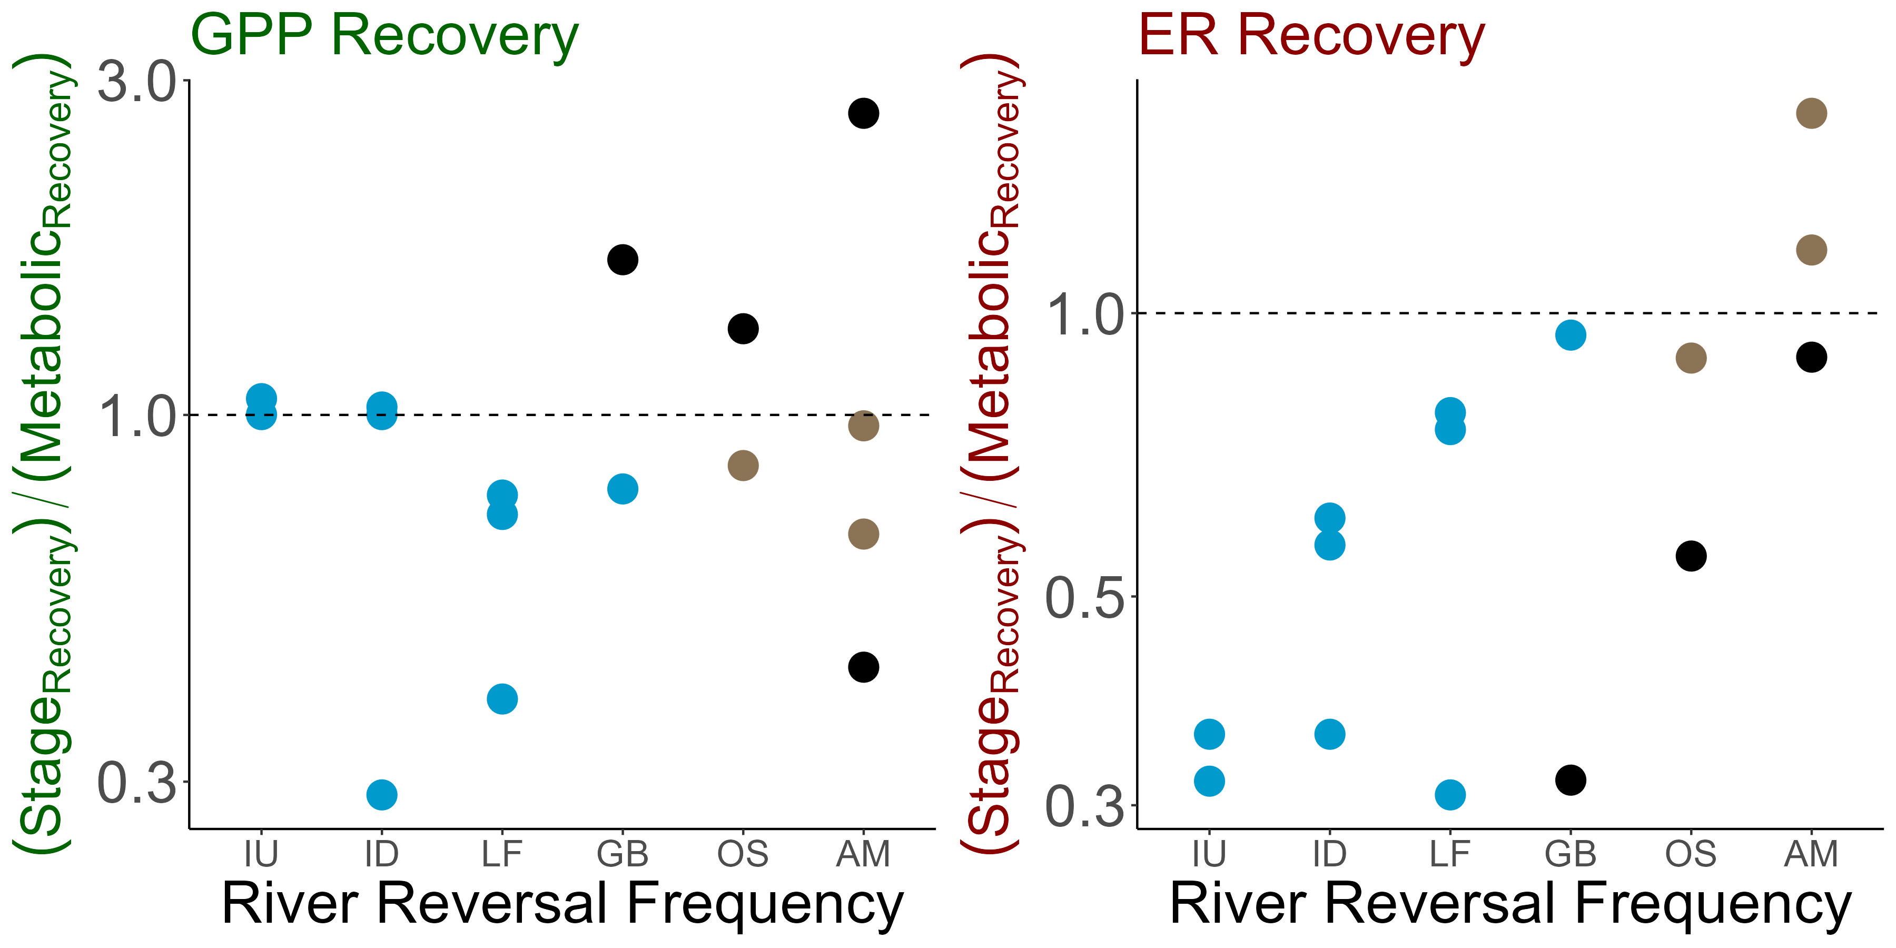
Spring metabolism recovered alongside or more quickly than stage. ER recovered more quickly in more disturbed springs, and GPP took longer to recover with increasing stage.
H2. Flood magnitude will be positively correlated with metabolic recovery time.
Notes:
In most cases, both GPP and ER recovered along-side, or more often, slower with stage.
Individually, recovery trend where similar to trends seen with reduction,
For GPP, as stage increased, metabolism took longer to recover than stage. Although, this trend is not significant. ER had no relationship between recovery and disturbance magnitude but…
Did have an increasing trend with disturbance regime, with sites experiencing a greater frequency of flow reversals experiencing quicker ER recoveries
GPP does not have any obvious relationships with disturbance regime

Slide 18
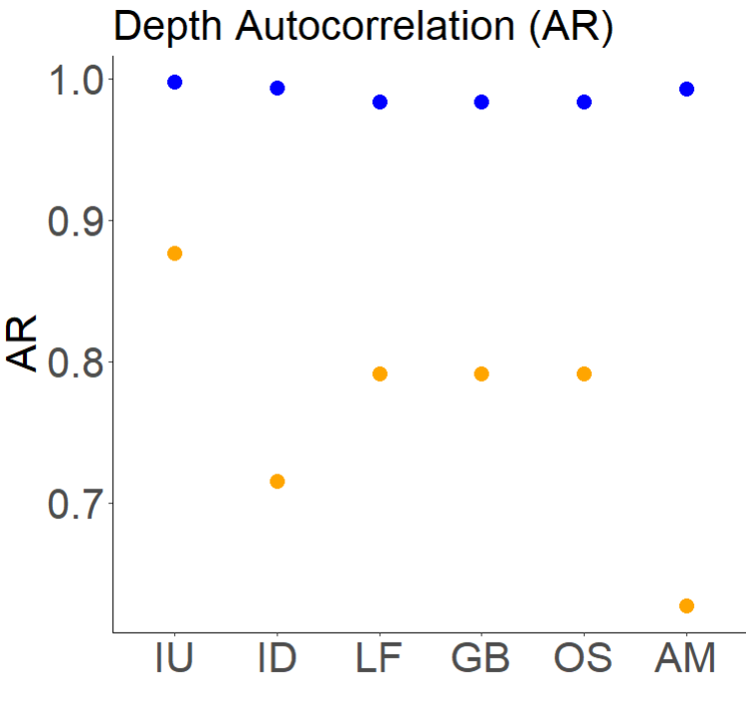
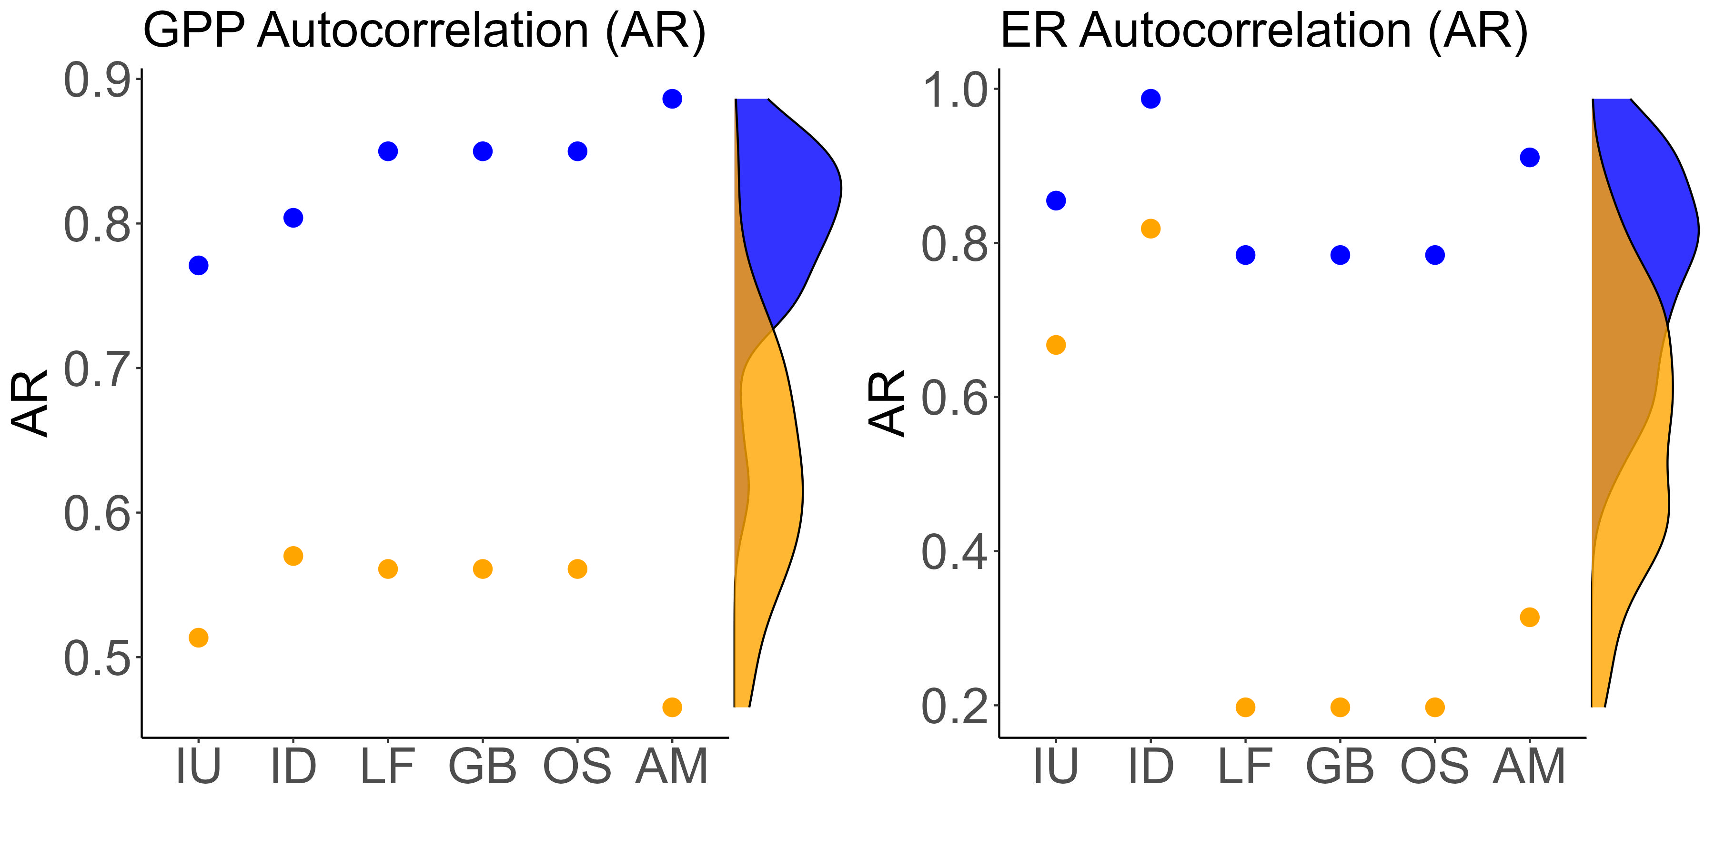

Less disturbed spring-runs had more stable metabolic regimes than more disturbed spring-runs.
Notes:
Lastly, With these results in mind, I wanted to investigate whether more disturbed springs were less chemostatic than less disturbed springs
Here I display the autocorrelation for each of my sites. The density data on the site is from Appling et al. 2020
My site followed the expected pattern with less disturbed sites having greater autocorrelation than more disturbed sites.
However, AR1 for GPP was unexpected with more chemostatic sites displaying weaker autocorrelations than my more disturbed sites. Specifically, IU which is the farthest from its blackwater river.

Slide 19
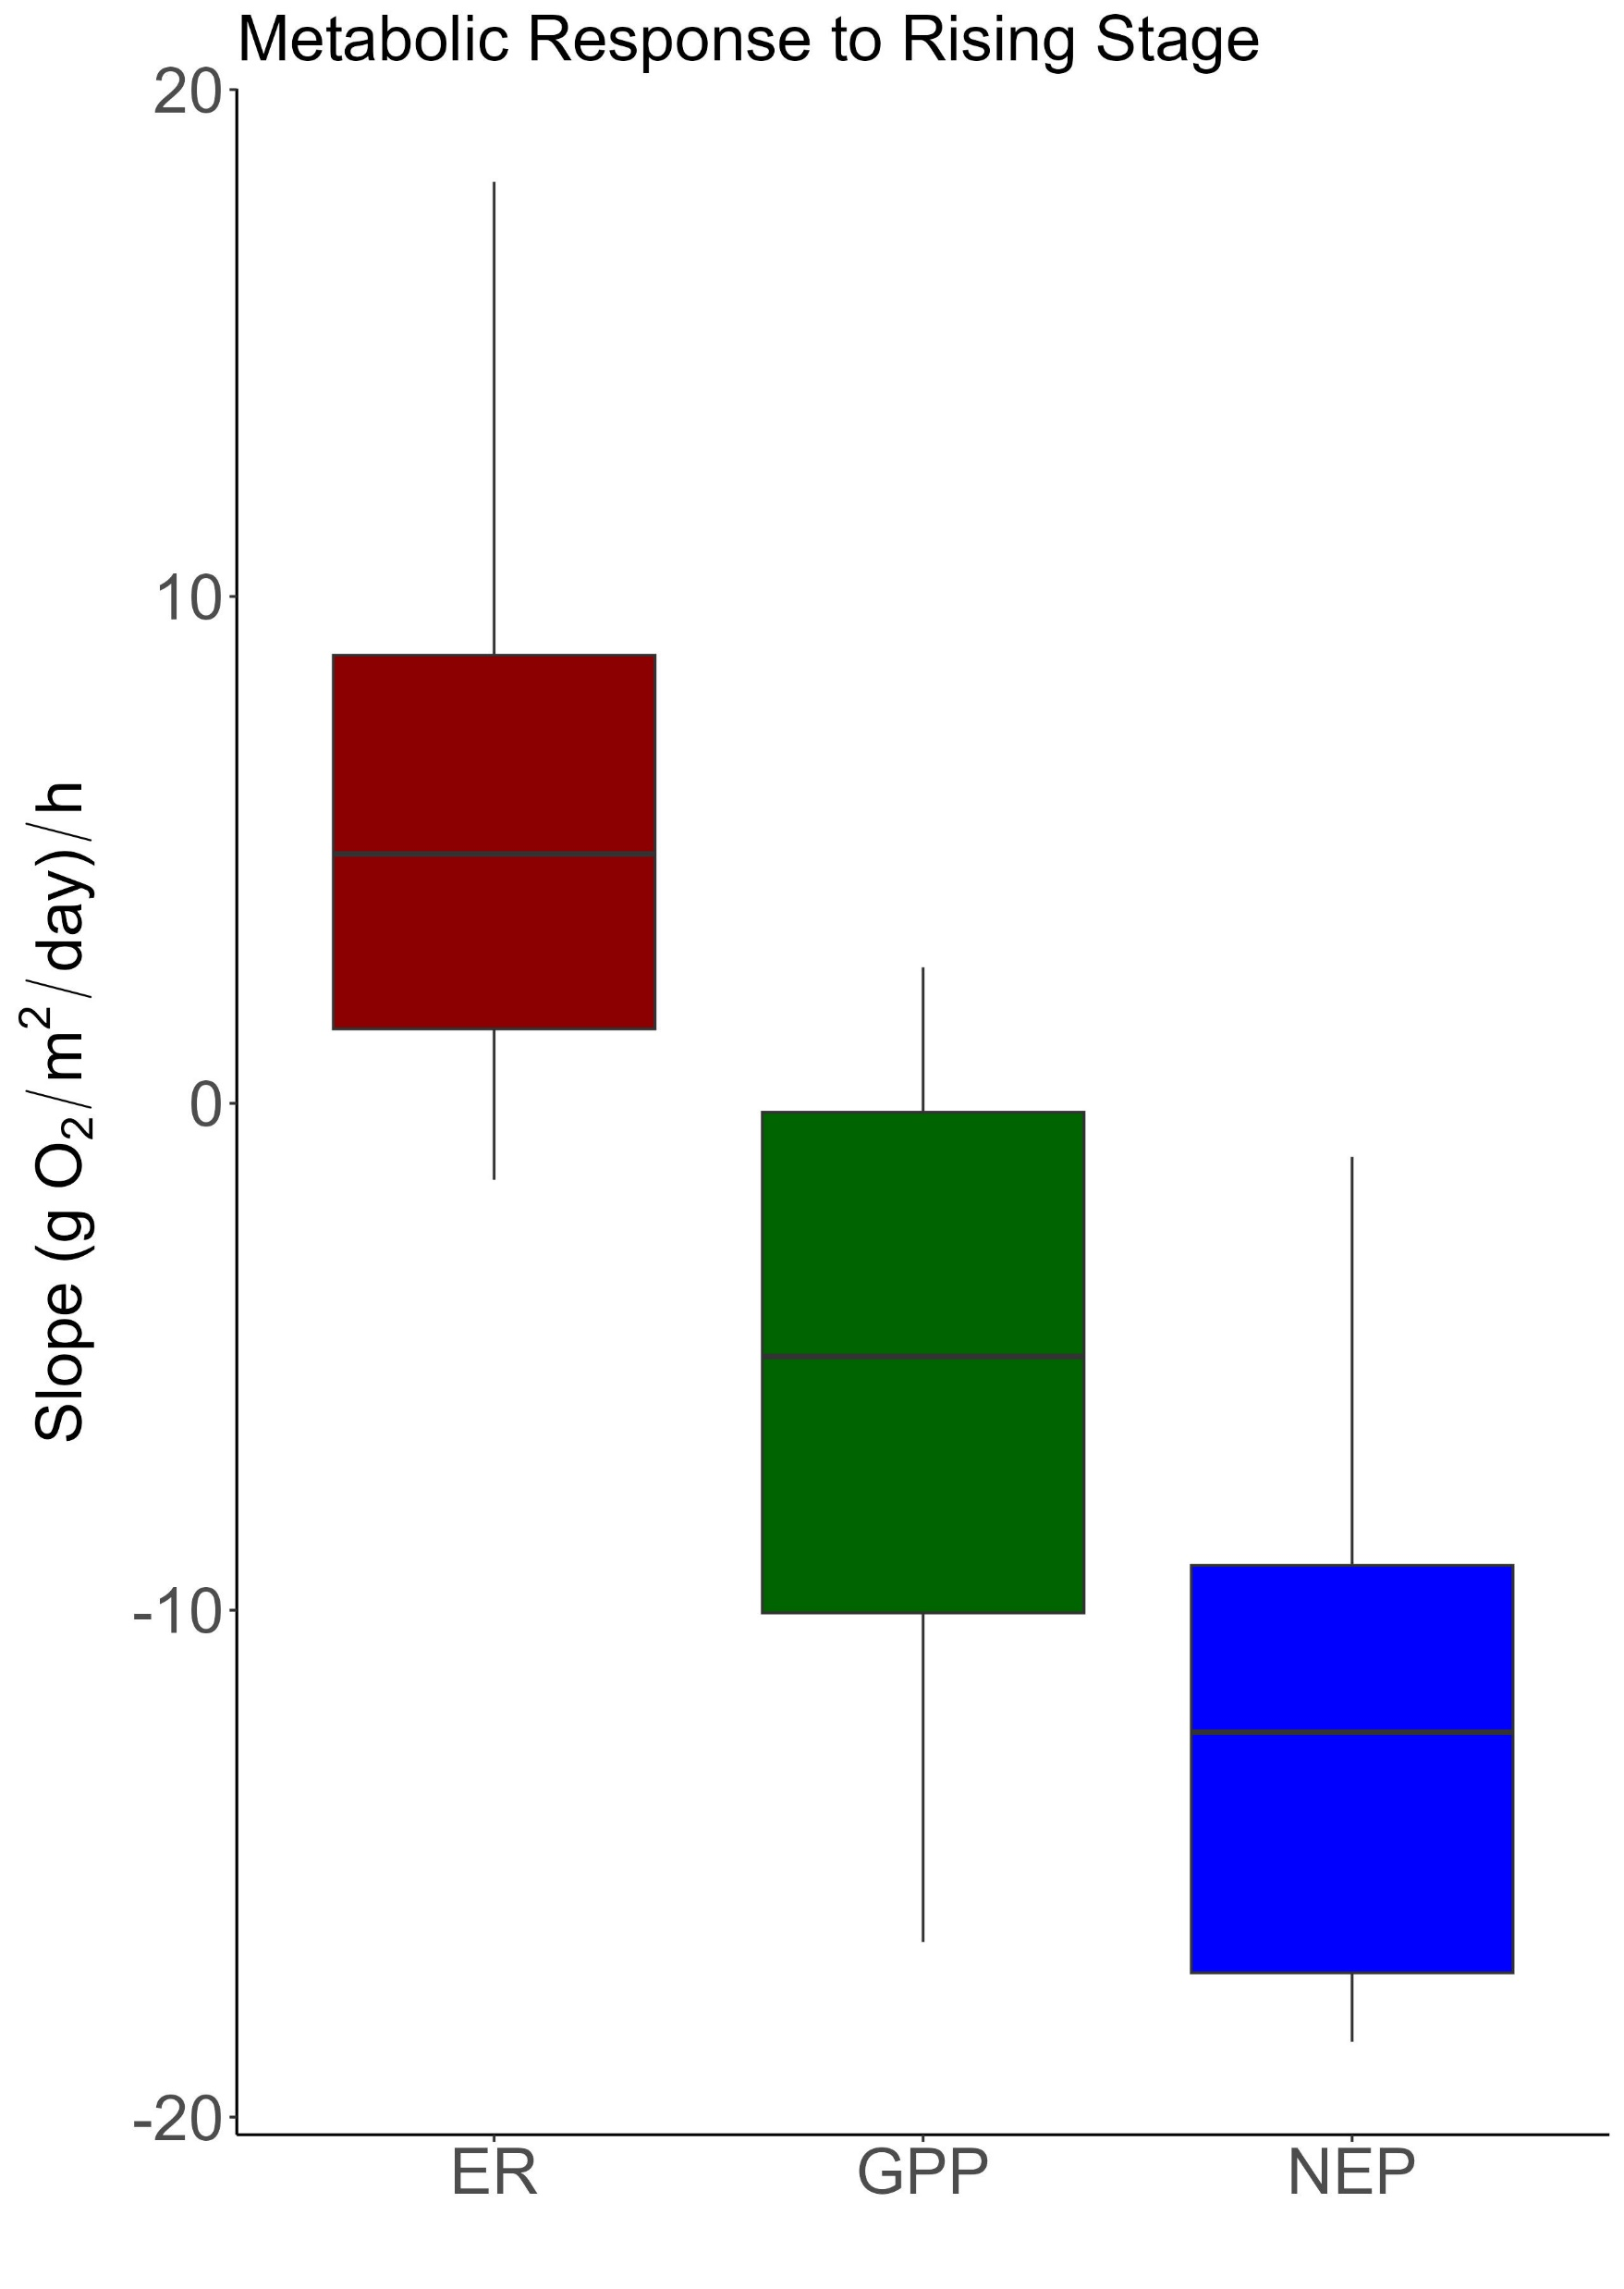


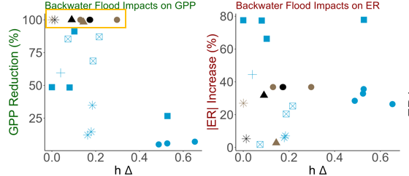
Bernhardt et al. 2018; Mullholand et al. 2001; Hensley et al. 2017; Uehlinger et al. 2000; Donsky 2023
Indicating light availability is a major factor in spring-metabolism
Site: OS
Stage and productivity have a negative relationship, regardless of river influence.
, Spring floods did not result in proportional ER increases, but none the less an increase.
, River reversals drove GPP to 0, regardless of disturbance magnitude.
Site: OS
Notes:
This paints a unique picture of spring-run metabolic regime
Increased stage was significantly correlated with a decrease in productivity. However, once light was extinguished by the river, GPP became 0
Indicating light availability is a major factor in spring metabolism
There swapping of headwaters is less important, once light is attenuated, there the spring-run will have a metabolic response.

Slide 20
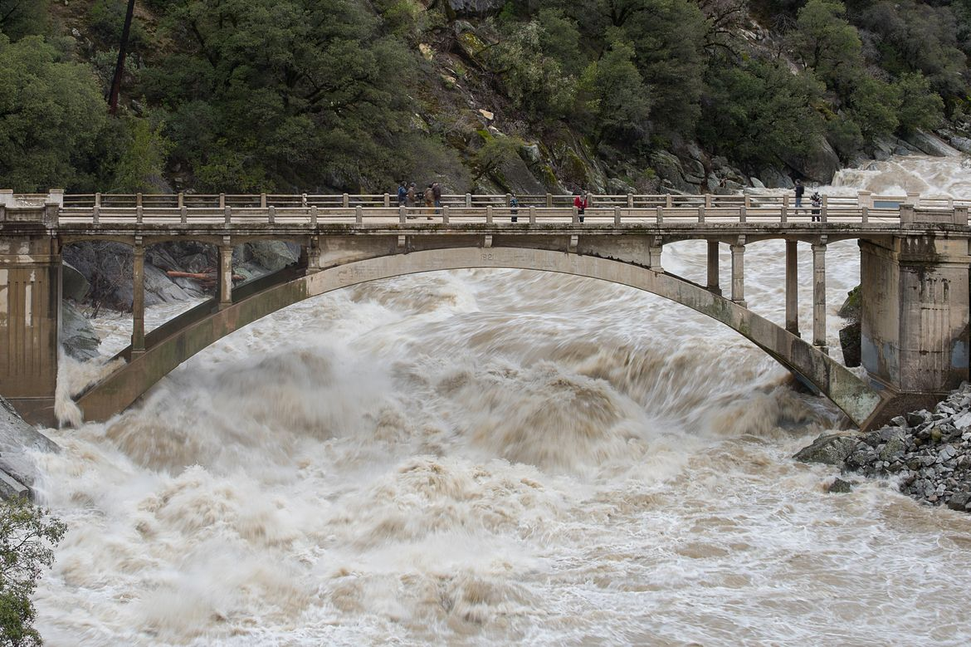

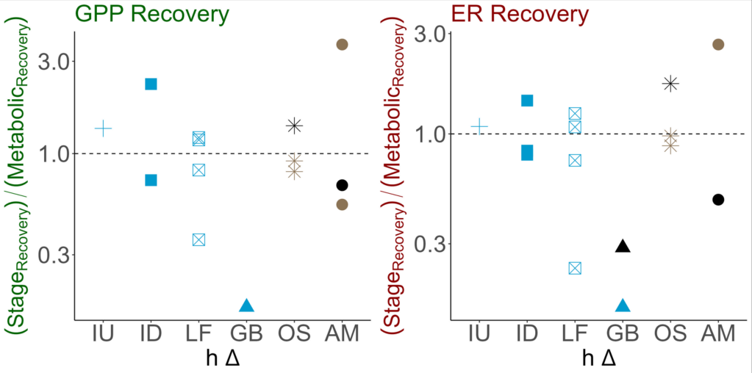
Spring metabolism recovered more quickly or as quickly as stage
Light availability determines productivity, but the retention of the benthos decides recovery
Site: ID
Notes:
Yet, spring metabolism recovered along side stage, indicating that although light influence the metabolic response, its bed scour determines recovery time
Since the spring-runs retain their benthos, once light returns, they once again can photosynthesize resulting in a quick recovery time,

Slide 21
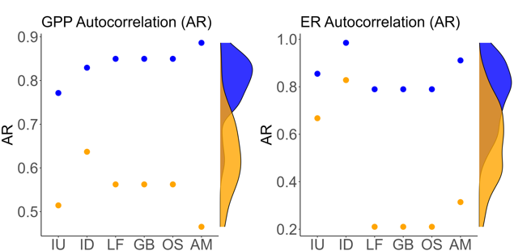

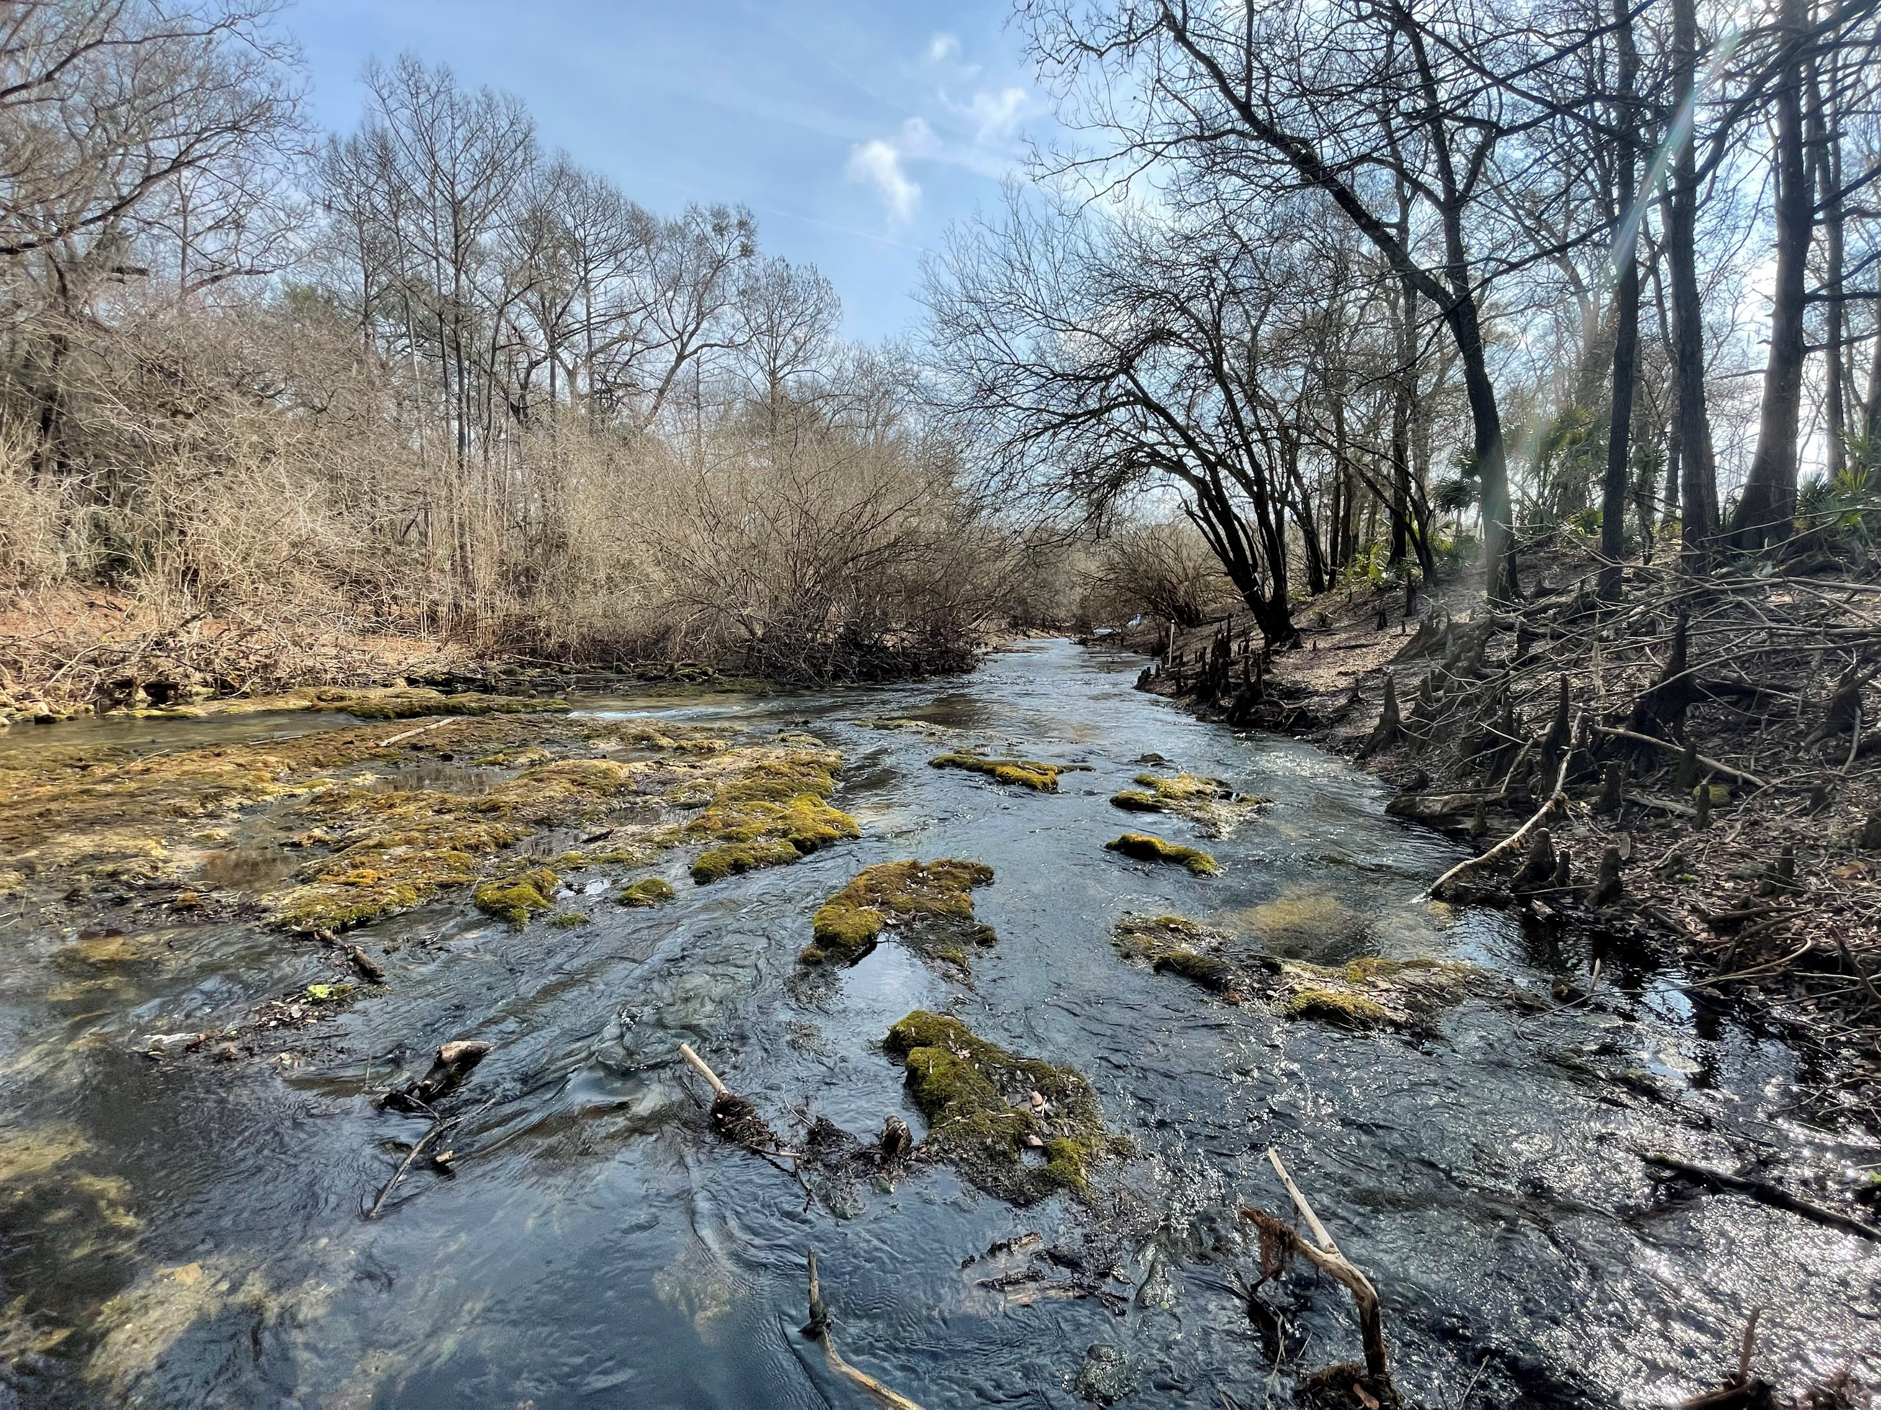
Overall, less disturbed spring-runs had more stable metabolic regimes than more disturbed spring-runs.
Ichetucknee Headspring
Allen Mill Pond
Rum Springs
Metabolic Stability
Notes:
And lastly, I found North Florida spring-runs span a gradient of flow regimes dependent on their disturbance regime
With some springs truly being some-what chemostatic and some…not

Slide 22




































































… and as such, disturbance is a key factor in spring-run regime and function
CO₂
CO₂
CO₂
CO₂
Thank you!
samanthahowley@ufl.edu
CO₂
CO₂
CO₂
CO₂
CO₂
CO₂
CO₂
CO₂
Notes:
And as such, disturbance is a key factor in spring-run metabolic regime and function, like any other flowing waters
Thank you!

Slide 23
Appendix

Slide 24
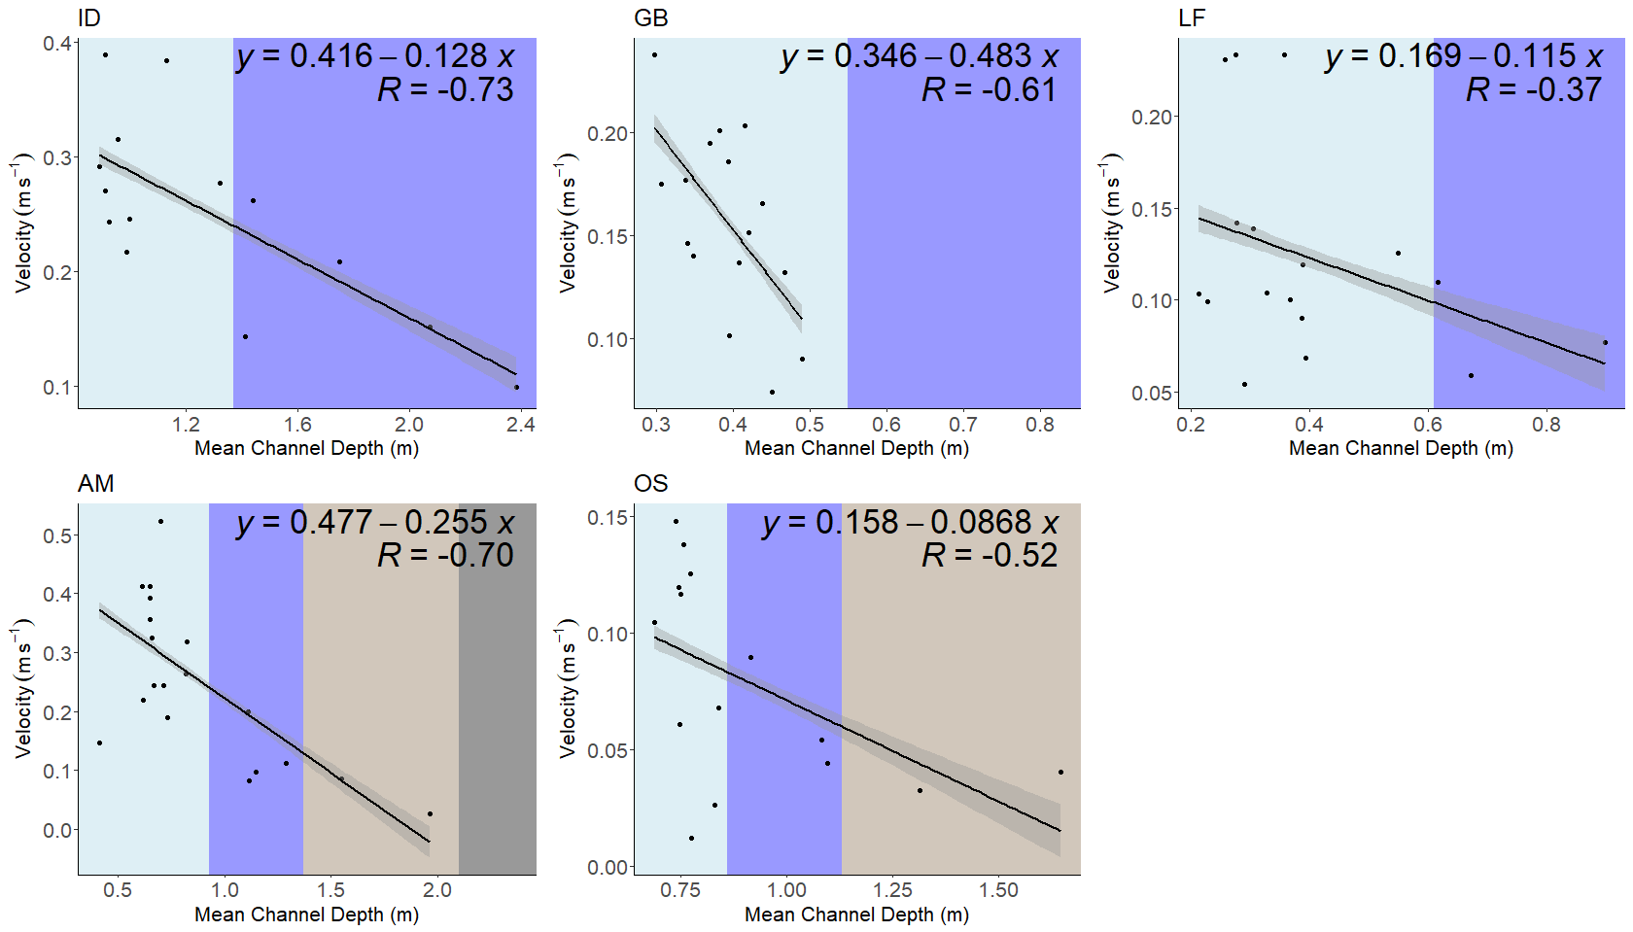


Slide 25
